Slide 1
Predicting Linear Epitopes in the SARS-CoV-2 Spike Protein
Natalie Rshaidat

Slide 2
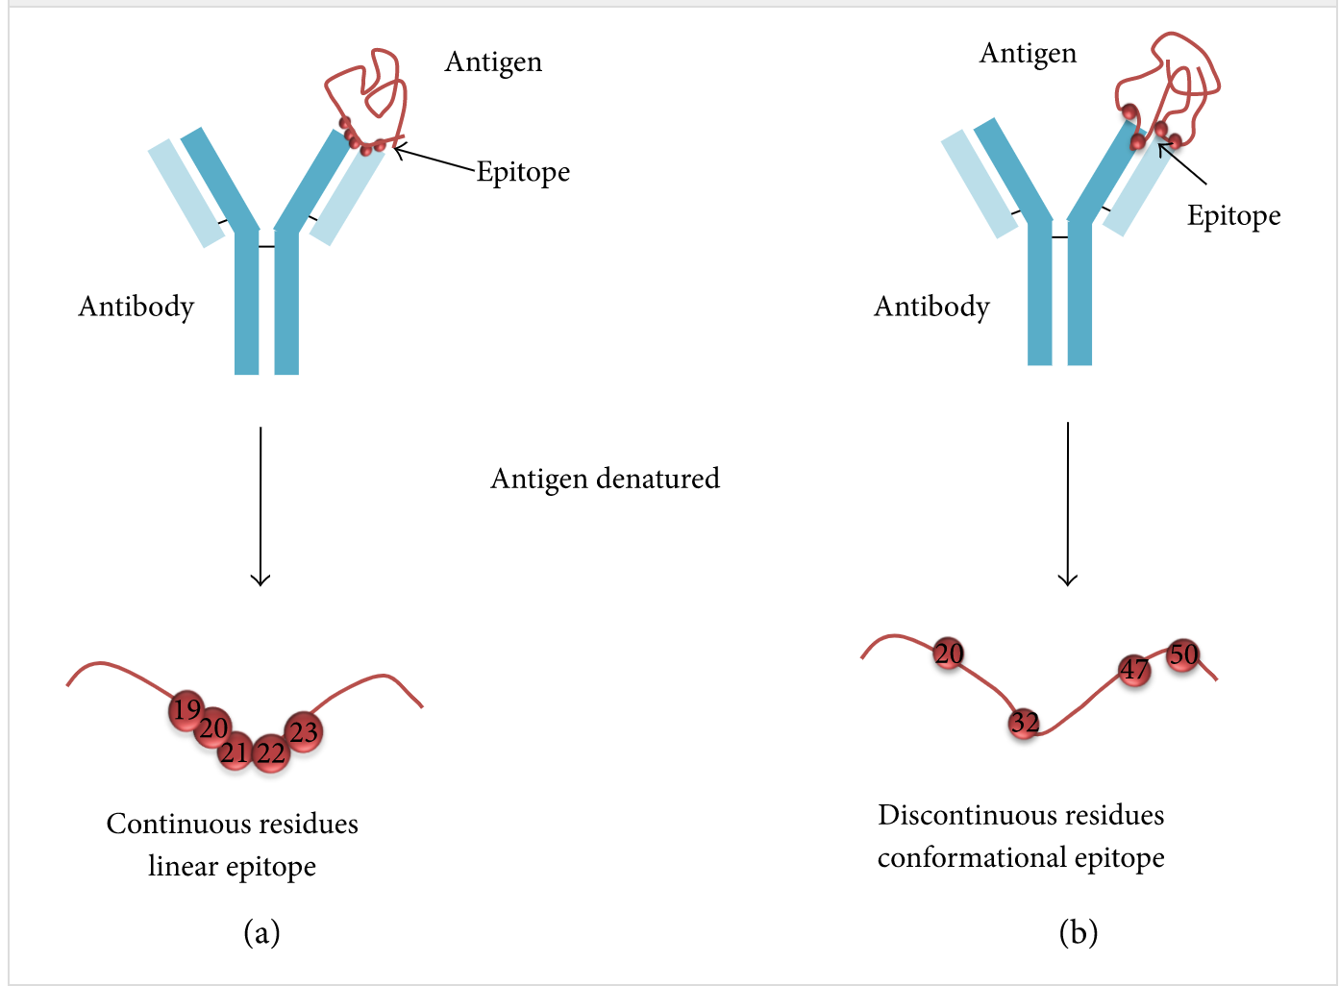
What is an epitope?
Spike Protein in SARS CoV-2
Usually between 5 to 25 amino acids long
J.L. Sanchez-Trincado, M. Gomez-Perosanz, P.A. Reche Fundamentals and methods for T-and B-cell epitope prediction J Immunol Res, 2017 (2017), 10.1155/2017/2680160

Slide 3
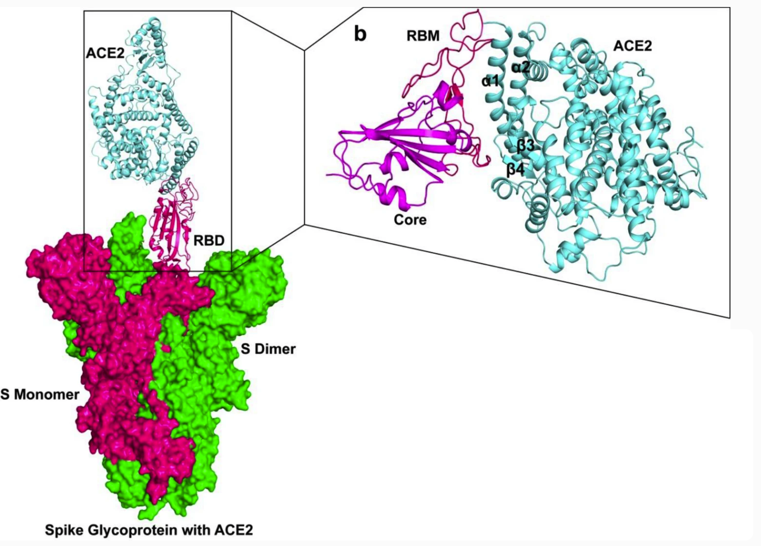
Spike Protein
Potential Epitope Regions:
RBD
RBM (part of RBD)
S2
Citation:
Rathod, S.B., Prajapati, P.B., Punjabi, L.B. et al. Peptide modelling and screening against human ACE2 and spike glycoprotein RBD of SARS-CoV-2. In Silico Pharmacol. 8, 3 (2020). https://doi.org/10.1007/s40203-020-00055-w
S1

Slide 4
Modeling The Problem in Machine Learning
Predicting if a protein is an epitope is a classification problem
Random Forest Classifier can model the problem, however the model’s accuracy relies on its feature selection and representation of the protein sequences
N-grams can be used to represent the protein sequences
Physicochemical features of the protein can also aid in predicting epitopes

Slide 5
Encoding Protein Sequences
Combination of n-gram Descriptors Frequency
n = 2
Create a list of all the possible 2 symbol combinations for our 20 amino acids: ([AA, AC, AU, AP, etc..]
Each combination of letters was then mapped to an index between 0 and 400
Sequence = CTAUCT
Split sequence into:
[CT, TA, AU, UC, CT]
Frequency = [0, 0, 0, …] (400)
Count the frequency of each pair in the sequence:
CT index = 0
TA index = 2
AU index = 3
UC index = 5
Frequency = [2, 0, 1, 1, 0, 1, ...] (divide by the number of pairs in the sequence)
Frequency = [0.4, 0, 0.2, 0.2, 0, 0.2, ...] = sum to 1
Citation:
Muhammad Javed Iqbal, Ibrahima Faye, Brahim Belhaouari Samir, Abas Md Said, "Efficient Feature Selection and Classification of Protein Sequence Data in Bioinformatics", The Scientific World Journal, vol. 2014, Article ID 173869, 12 pages, 2014. https://doi.org/10.1155/2014/173869

Slide 6
Features
Random Forest Classifier with these features: (403 features)
% Frequency Amino Acid Pairs Composition (400 amino acid pairs)
Charge in Human blood ph of 7.5 (using bioPython)
Instability index (using bioPython)
Uses the method described by Guruprasad et al. (1990, Protein Engineering, 4, 155-161)
Gravy (grand average of hydropathy) score: (using bioPython)
The hydropathy index of an amino acid is a number representing the hydrophobic or hydrophilic properties of its side-chain.
Notes:
RFC because the best epitope prediction software BediPred2.0 uses it and other researchers have also found that it performs the best.

Slide 7
The Model’s Performance
Model:
Sequence as Features
Training Size: 22917 data points (80%)
Testing size: 7639 data points (20%)
Data: B-Cell Linear Epitope dataset from Bepi-Pred 2.0
Mean AUC: 0.78288
Jespersen MC, Peters B, Nielsen M, Marcatili P. BepiPred-2.0: improving sequence-based B-cell epitope prediction using conformational epitopes. Nucleic Acids Res 2017 (Web Server issue). doi: 10.1093/nar/gkx352

Slide 8
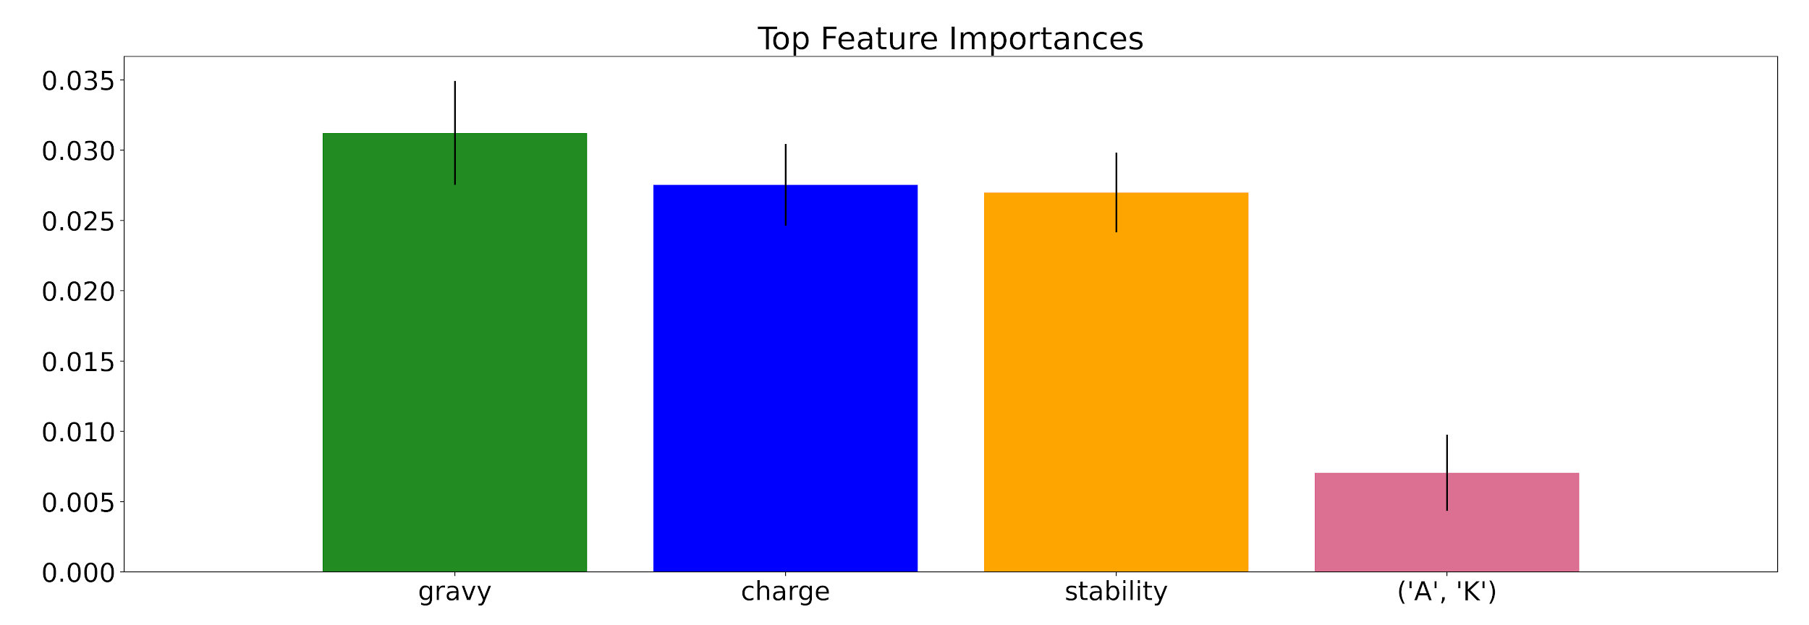
Feature Importances:

Slide 9
Spike Protein Preprocessing
Slicing the protein into subsequences of sizes between 6 and 25 using k-mers decomposition.
For each of these subsequences, pair sequence frequencies were counted and the physicochemical features were calculated
After feature extraction was made on each subsequence, they were passed to the model for prediction

Slide 10
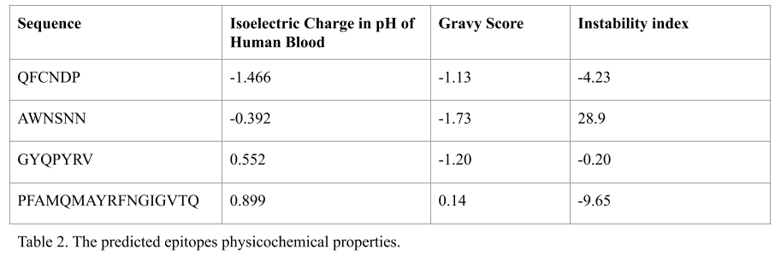
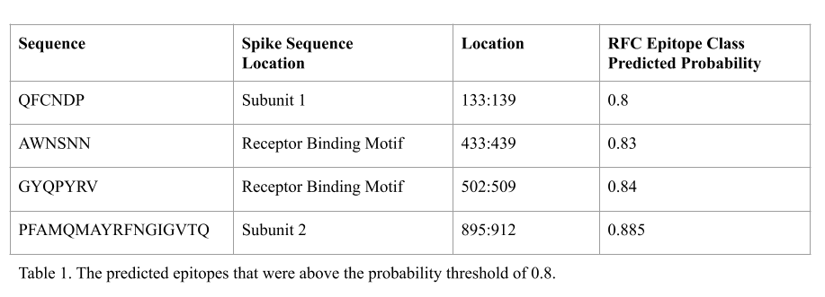
Predictions in the Spike Protein

Slide 11
Limitations
Model’s predictive power limited to the data used to train it
Some predicted epitopes were found in the training set
Feature selection was limited by computational costs

Slide 12
Future Directions
Future explorations could look at the peptide’s structural alignments with known conformational B-cell epitopes.
Differing feature representation of the peptide sequences, such as solely physicochemical features and structural features.
Research of the structural epitopes for the differing structural representations of the spike protein, i.e. the up vs the down conformational structures.
Explorations in conserved epitopes that can be effective to the variations of the virus infecting different global populations could also be of value in vaccine production.

